Slide 1


4. Greedy Algorithms II
Dijkstra's algorithm
minimum spanning trees
Prim, Kruskal, Boruvka
single-link clustering
min-cost arborescences
Lecture slides by Kevin Wayne Copyright © 2005 Pearson-Addison Wesley
Copyright © 2013 Kevin Wayne
http://www.cs.princeton.edu/~wayne/kleinberg-tardos
Last updated on Sep 8, 2013 6:30 AM

Slide 2


4. Greedy Algorithms II
Dijkstra's algorithm
minimum spanning trees
Prim, Kruskal, Boruvka
single-link clustering
min-cost arborescences
Section 4.4

Slide 3
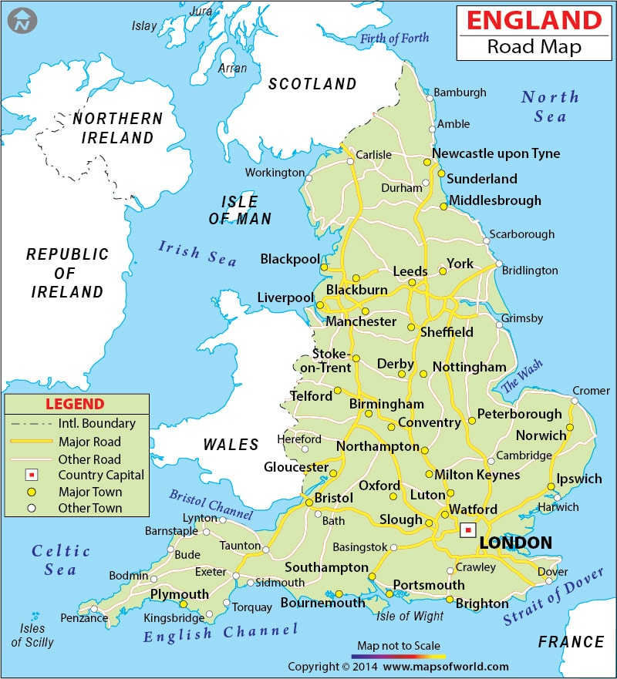

Slide 4
Shortest-paths problem
Problem. Given a digraph G = (V, E), edge lengths ℓe ≥ 0, source s ∈ V, and destination t ∈ V, find the shortest directed path from s to t.
1
15
3
5
4
source s
0
12
3
8
7
7
2
9
9
6
1
11
5
5
4
13
4
20
6
destination t
length of path = 9 + 4 + 1 + 11 = 25

Slide 5

Car navigation

Slide 6
Shortest path applications
・PERT/CPM.
・Map routing.
・Seam carving.
・Robot navigation.
・Texture mapping.
・Typesetting in LaTeX.
・Urban traffic planning.
・Telemarketer operator scheduling.
・Routing of telecommunications messages.
・Network routing protocols (OSPF, BGP, RIP).
・Optimal truck routing through given traffic congestion pattern.
Reference: Network Flows: Theory, Algorithms, and Applications, R. K. Ahuja, T. L. Magnanti, and J. B. Orlin, Prentice Hall, 1993.

Slide 7
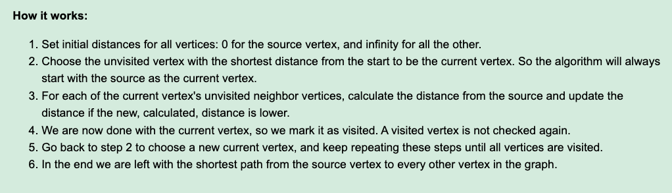
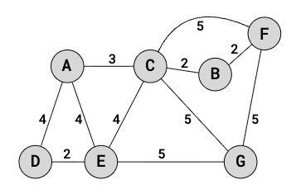
Dijkstra's algorithm

Slide 8
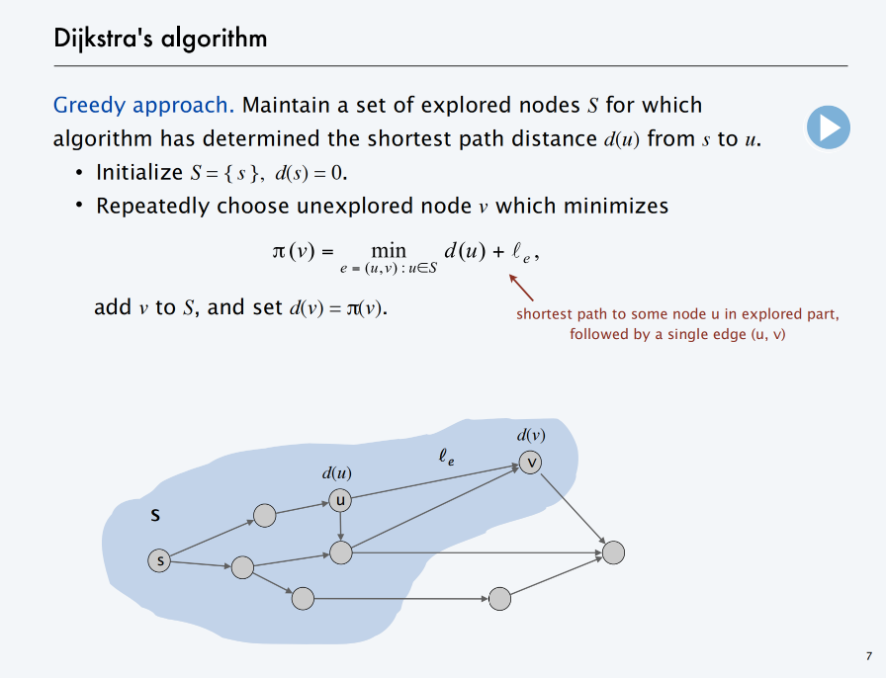

Slide 9
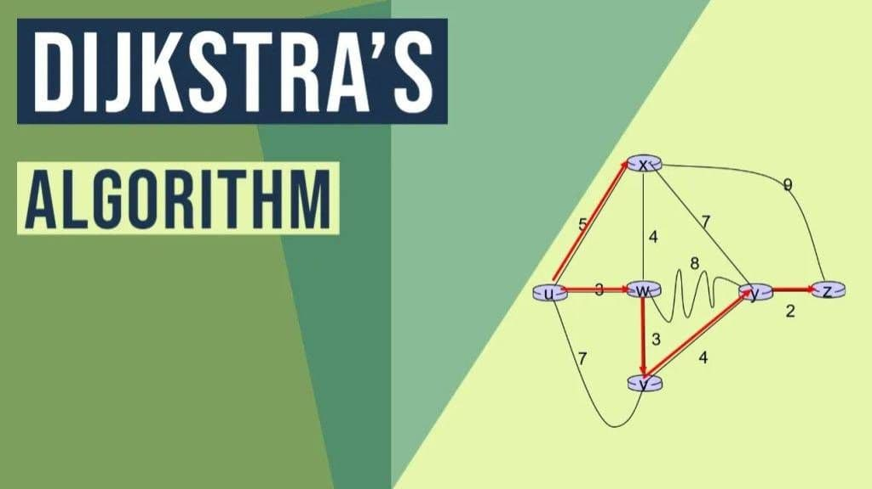
https://www.youtube.com/watch?v=EFg3u_E6eHU&t=8s

Slide 10




Dijkstra's algorithm: proof of correctness
Invariant. For each visited node u ∈ S, d(u) is the length of the shortest s↝u path.
Pf. [ by induction on | S | ]
Base case: | S | = 1 is easy since S = { s } and d(s) = 0. Inductive hypothesis: Assume true for | S | = k ≥ 1.
・Let v be next node added to S, and let (u, v) be the final edge.
・The shortest s↝u path plus (u, v) is an s↝v path of length π(v).
・Consider any s↝v path P. We show that it is no shorter than π(v).
・Let (x, y) be the first edge in P that leaves S,
P'
y
x
and let P' be the subpath to x.
・P is already too long as soon as it reaches y.
s
P
S
u
ℓ(P) ≥ ℓ(P') + ℓ(x, y)
≥ d(x) + ℓ(x, y) ≥ π (y) ≥ π (v)
▪
v
nonnegative lengths
inductive hypothesis
definition of π(y)
Dijkstra chose v instead of y

Slide 11

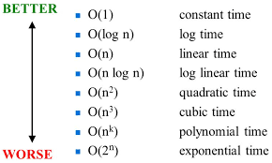
Dijkstra's algorithm: efficient implementation
Critical optimization 1. For each unexplored node v, explicitly maintain π(v) instead of computing directly from formula:
π (v) =
min d (u) + ℓ _{e} .
e = (u,v ) : u ∈ S
・For each v ∉ S, π (v) can only decrease (because S only increases).
・More specifically, suppose u is added to S and there is an edge (u, v)
leaving u. Then, it suffices to update:
π (v) = min { π (v), d(u) + ℓ(u, v) }
Critical optimization 2. Use a priority queue to choose the unexplored node that minimizes π (v).

Slide 12
Dijkstra's algorithm: efficient implementation
Implementation.
・Algorithm stores d(v) for each explored node v.
・Priority queue stores π (v) for each unexplored node v.
・Recall: d(u) = π (u) when u is deleted from priority queue.
Dijkstra (V, E, s)
Create an empty priority queue.
FOR EACH v ≠ s : d(v) ← ∞; d(s) ← 0.
FOR EACH v ∈ V : insert v with key d(v) into priority queue. WHILE (the priority queue is not empty)
u ← delete-min from priority queue. FOR EACH edge (u, v) ∈ E leaving u:
IF d(v) > d(u) + ℓ(u, v)
decrease-key of v to d(u) + ℓ(u, v) in priority queue.
d(v) ← d(u) + ℓ(u, v).

Slide 13





Extensions of Dijkstra's algorithm
Dijkstra's algorithm and proof extend to several related problems:
・Shortest paths in undirected graphs: d(v) ≤ d(u) + ℓ(u, v).
・Maximum capacity paths: d(v) ≥ min { π (u), c(u, v) }.
・Maximum reliability paths: d(v) ≥ d(u) 𐄂 γ(u, v) .
・…
Key algebraic structure. Closed semiring (tropical, bottleneck, Viterbi).
ℓ_{e}
v
d(u)
u
S
s

Slide 14
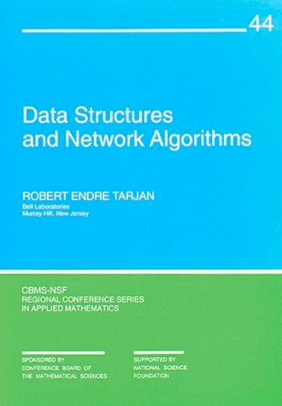
4. Greedy Algorithms II
Dijkstra's algorithm
minimum spanning trees
Prim, Kruskal, Boruvka
single-link clustering
min-cost arborescences
Section 6.1

Slide 15
Cycles and cuts
Def. A path is a sequence of edges which connects a sequence of nodes.
Def. A cycle is a path with no repeated nodes or edges other than the starting and ending nodes.
2
3
1
6
5
4
7
8
cycle C = { (1, 2), (2, 3), (3, 4), (4, 5), (5, 6), (6, 1) }

Slide 16
Cycles and cuts
Def. A cut is a partition of the nodes into two nonempty subsets S and V – S.
Def. The cutset of a cut S is the set of edges with exactly one endpoint in S.
2
3
1
6
5
4
cut S
7
8
cutset D = { (3, 4), (3, 5), (5, 6), (5, 7), (8, 7) }

Slide 17
Cycle-cut intersection
Proposition. A cycle and a cutset intersect in an even number of edges.
2
3
1
6
5
4
7
8
cutset D = { (3, 4), (3, 5), (5, 6), (5, 7), (8, 7) }
cycle C = { (1, 2), (2, 3), (3, 4), (4, 5), (5, 6), (6, 1) }
intersection C Ω D = { (3, 4), (5, 6) }

Slide 18


Cycle-cut intersection
Proposition. A cycle and a cutset intersect in an even number of edges. Pf. [by picture]
S
cycle C

Slide 19

Spanning tree properties
Proposition. Let T = (V, F) be a subgraph of G = (V, E). TFAE:
・T is a spanning tree of G.
・T is acyclic and connected.
・T is connected and has n – 1 edges.
・T is acyclic and has n – 1 edges.
・T is minimally connected: removal of any edge disconnects it.
・T is maximally acyclic: addition of any edge creates a cycle.
・T has a unique simple path between every pair of nodes. (A simple path is a path that does not repeat any vertices (and therefore also does not repeat any edges).
T = (V, F)

Slide 20
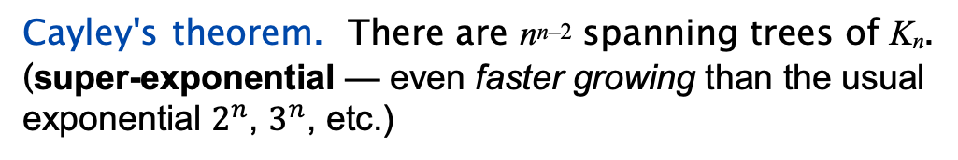
Minimum spanning tree
Given a connected graph G = (V, E) with edge costs c_{e}, an MST is a subset of the edges T ⊆ E such that T is a spanning tree whose sum of edge costs is minimized.
4
24
6
23
9
18
16
5
11
8
10
14
7
21
MST cost = 50 = 4 + 6 + 8 + 5 + 11 + 9 + 7
Cayley's theorem. There are n^{n–2} spanning trees of K_{n}.
(super-exponential — even faster growing than the usual exponential $2^{n}$, $3^{n}$, etc.)
can't solve by brute force

Slide 21
Applications
MST is fundamental problem with diverse applications.
・Dithering.
・Cluster analysis.
・Max bottleneck paths.
・Real-time face verification.
・LDPC codes for error correction.
・Image registration with Renyi entropy.
・Find road networks in satellite and aerial imagery.
・Reducing data storage in sequencing amino acids in a protein.
・Model locality of particle interactions in turbulent fluid flows.
・Autoconfig protocol for Ethernet bridging to avoid cycles in a network.
・Approximation algorithms for NP-hard problems (e.g., TSP, Steiner tree).
・Network design (communication, electrical, hydraulic, computer, road).

Slide 22

Fundamental cycle
Fundamental cycle.
・Adding any non-tree edge e to a spanning tree T forms unique cycle C.
・Deleting any edge f ∈ C from T ∪ { e } results in new spanning tree.
e
f
T = (V, F)
Observation. If ce < cf, then T is not an MST.

Slide 23
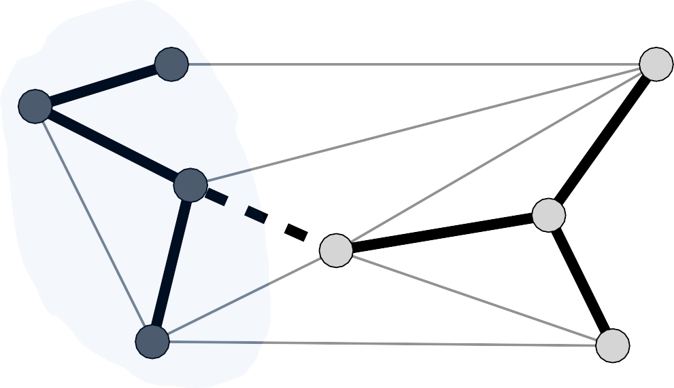
Fundamental cutset
Fundamental cutset.
・Deleting any tree edge f from a spanning tree T divide nodes into two connected components. Let D be cutset.
・Adding any edge e ∈ D to T – { f } results in new spanning tree.
e
f
T = (V, F)
Observation. If ce < cf, then T is not an MST.

Slide 24
The greedy algorithm
Red rule.
・Let C be a cycle with no red edges.
・Select an uncolored edge of C of max weight and color it red.
Blue rule.
・Let D be a cutset with no blue edges.
・Select an uncolored edge in D of min weight and color it blue.
Greedy algorithm.
・Apply the red and blue rules (non-deterministically!) until all edges are colored. The blue edges form an MST.
・Note: can stop once n – 1 edges colored blue.

Slide 25
Greedy algorithm: proof of correctness
Color invariant. There exists an MST T* containing all of the blue edges and none of the red edges.
Pf. [by induction on number of iterations]
Base case. No edges colored ⇒ every MST satisfies invariant.

Slide 26




Greedy algorithm: proof of correctness
Color invariant. There exists an MST T* containing all of the blue edges and none of the red edges.
Pf. [by induction on number of iterations]
Induction step (blue rule). Suppose color invariant true before blue rule.
・let D be chosen cutset, and let f be edge colored blue.
・if f ∈ T*, T* still satisfies invariant.
・Otherwise, consider fundamental cycle C by adding f to T*.
・let e ∈ C be another edge in D.
・e is uncolored and ce ≥ cf since
- e ∈ T* ⇒ e not red
- blue rule ⇒ e not blue and ce ≥ cf
T*
・Thus, T* ∪ { f } – { e } satisfies invariant.
f
e

Slide 27
Greedy algorithm: proof of correctness
Color invariant. There exists an MST T* containing all of the blue edges and none of the red edges.
Pf. [by induction on number of iterations]
Induction step (red rule). Suppose color invariant true before red rule.
・let C be chosen cycle, and let e be edge colored red.
・if e ∉ T*, T* still satisfies invariant.
・Otherwise, consider fundamental cutset D by deleting e from T*.
・let f ∈ D be another edge in C.
・f is uncolored and ce ≥ cf since
- f ∉ T* ⇒ f not blue
- red rule ⇒ f not red and ce ≥ cf
T*
・Thus, T* ∪ { f } – { e } satisfies invariant. ▪
f
e

Slide 28
Greedy algorithm: proof of correctness
Theorem. The greedy algorithm terminates. Blue edges form an MST. Pf. We need to show that either the red or blue rule (or both) applies.
・Suppose edge e is left uncolored.
・Blue edges form a forest.
・Case 1: both endpoints of e are in same blue tree.
⇒ apply red rule to cycle formed by adding e to blue forest.
e
Case 1

Slide 29
Greedy algorithm: proof of correctness
Theorem. The greedy algorithm terminates. Blue edges form an MST. Pf. We need to show that either the red or blue rule (or both) applies.
・Suppose edge e is left uncolored.
・Blue edges form a forest.
・Case 1: both endpoints of e are in same blue tree.
⇒ apply red rule to cycle formed by adding e to blue forest.
・Case 2: both endpoints of e are in different blue trees.
⇒ apply blue rule to cutset induced by either of two blue trees. ▪
e
Case 2

Slide 30
4. Greedy Algorithms II
Dijkstra's algorithm
minimum spanning trees
Prim, Kruskal, Boruvka
single-link clustering
min-cost arborescences
Section 6.2

Slide 31
Prim's algorithm
Initialize S = any node. Repeat n – 1 times:
・Add to tree the min weight edge with one endpoint in S.
・Add new node to S.
Theorem. Prim's algorithm computes the MST.
Pf. Special case of greedy algorithm (blue rule repeatedly applied to S). ▪
S

Slide 32
Prim's algorithm: implementation
Theorem. Prim's algorithm can be implemented in O(m log n) time. (linearithmic time)
Pf. Implementation almost identical to Dijkstra's algorithm.
[ d(v) = weight of cheapest known edge between v and S ]
Prim (V, E, c)
Create an empty priority queue.
s ← any node in V.
FOR EACH v ≠ s : d(v) ← ∞; d(s) ← 0.
FOR EACH v : insert v with key d(v) into priority queue.
WHILE (the priority queue is not empty) u ← delete-min from priority queue.
FOR EACH edge (u, v) ∈ E incident to u:
IF d(v) > c(u, v)
decrease-key of v to c(u, v) in priority queue.
d(v) ← c(u, v).

Slide 33
Kruskal's algorithm
Consider edges in ascending order of weight:
・Add to tree unless it would create a cycle.
Theorem. Kruskal's algorithm computes the MST. Pf. Special case of greedy algorithm.
・Case 1: both endpoints of e in same blue tree.
all other edges in cycle are blue
⇒ color red by applying red rule to unique cycle.
・Case 2. If both endpoints of e are in different blue trees.
⇒ color blue by applying blue rule to cutset defined by either tree. ▪
no edge in cutset has smaller weight (since Kruskal chose it first)
e

Slide 34
Kruskal's algorithm: implementation
Theorem. Kruskal's algorithm can be implemented in O(m log m) time.
・Sort edges by weight.
・Use union-find data structure to dynamically maintain connected components.
Kruskal (V, E, c)
SORT m edges by weight so that c(e1) ≤ c(e2) ≤ … ≤ c(em) S ← φ
foreach v ∈ V: MakeSet(v).
FOR i = 1 TO m
(u, v) ← ei
if FindSet(u) ≠ FindSet(v)
S ← S ∪ { ei }
make u and v in
are u and v in same component?
Union(u, v).
RETURN S
same component

Slide 35

Reverse-delete algorithm
Consider edges in descending order of weight:
・Remove edge unless it would disconnect the graph.
Theorem. The reverse-delete algorithm computes the MST.
Pf. Special case of greedy algorithm.
・Case 1: removing edge e does not disconnect graph.
⇒ apply red rule to cycle C formed by adding e to existing path
between its two endpoints
any edge in C with larger weight would have been deleted when considered
・Case 2: removing edge e disconnects graph.
⇒ apply blue rule to cutset D induced by either component. ▪
e is the only edge in the cutset
(any other edges must have been colored red / deleted)
Fact. [Thorup 2000] Can be implemented in O(m log n (log log n)³) time.

Slide 36
Review: the greedy MST algorithm (The End)
Red rule.
・Let C be a cycle with no red edges.
・Select an uncolored edge of C of max weight and color it red.
Blue rule.
・Let D be a cutset with no blue edges.
・Select an uncolored edge in D of min weight and color it blue.
Greedy algorithm.
・Apply the red and blue rules (non-deterministically!) until all edges are colored. The blue edges form an MST.
・Note: can stop once n – 1 edges colored blue.
Theorem. The greedy algorithm is correct. Special cases. Prim, Kruskal, reverse-delete, ...

Slide 37
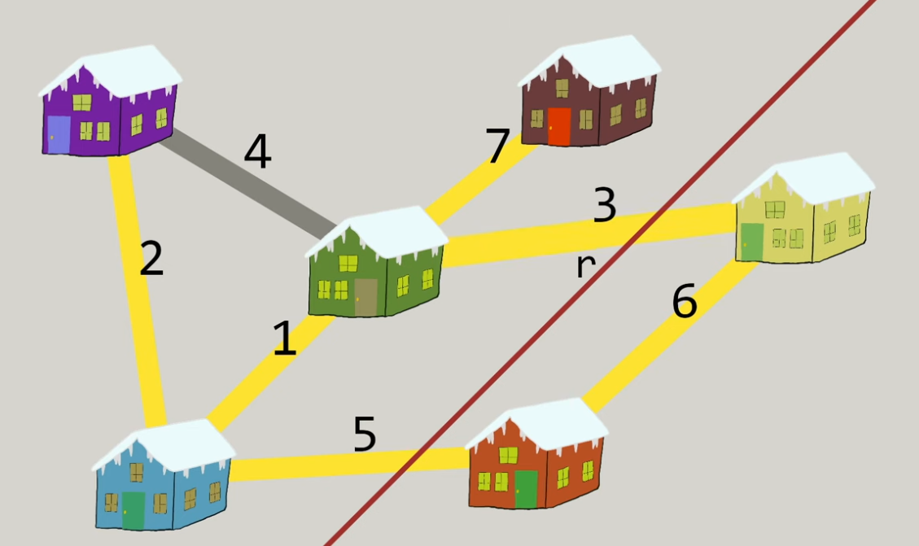
https://www.youtube.com/watch?v=Yldkh0aOEcg&t=181s

Slide 38
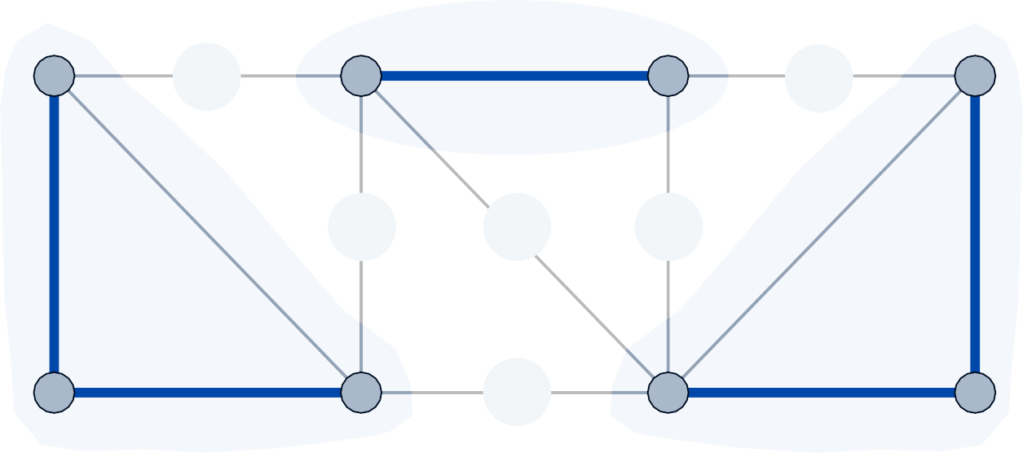
Borůvka's algorithm
Repeat until only one tree.
・Apply blue rule to cutset corresponding to each blue tree.
・Color all selected edges blue.
Theorem. Borůvka's algorithm computes the MST.
assume edge costs are distinct
Pf. Special case of greedy algorithm (repeatedly apply blue rule). ▪
7
11
8
12
5
13

Slide 39
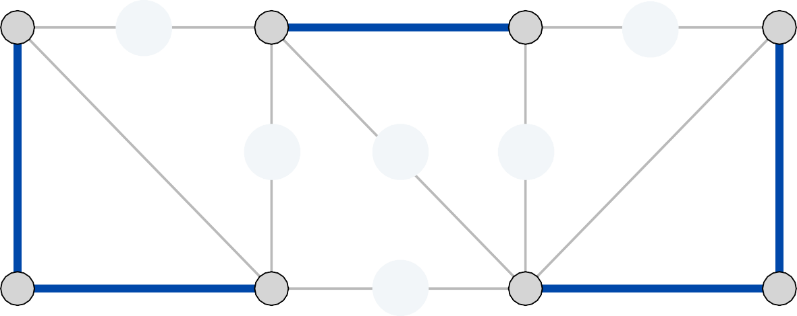
Borůvka's algorithm: implementation
Theorem. Borůvka's algorithm can be implemented in O(m log n) time.
Pf.
・To implement a phase in O(m) time:
compute connected components of blue edges
for each edge (u, v) ∈ E, check if u and v are in different components; if so, update each component's best edge in cutset
・At most log2 n phases since each phase (at least) halves total # trees. ▪
7
11
8
12
5
13

Slide 40


Borůvka's algorithm: implementation
Node contraction version.
・After each phase, contract each blue tree to a single supernode.
・Delete parallel edges (keeping only cheapest one) and self loops.
・Borůvka phase becomes: take cheapest edge incident to each node.
graph G
contract nodes 2 and 5
1
6
2
8
3
1
6
3
5
8
3
5
4
2
3
2, 5
2
7
9
4
7
5
9
6
4
6
1
1
delete parallel edges and self loops
1
3
5
8
3
2, 5
2
7
9
4
6
1
38

Slide 41
Borůvka's algorithm on planar graphs
Theorem. Borůvka's algorithm runs in O(n) time on planar graphs.
Pf.
・To implement a Borůvka phase in O(n) time:
use contraction version of algorithm
in planar graphs, m ≤ 3n – 6.
graph stays planar when we contract a blue tree
・Number of nodes (at least) halves.
・At most log2 n phases: cn + cn / 2 + cn / 4 + cn / 8 + … = O(n). ▪
planar
not planar
39

Slide 42
Borůvka-Prim algorithm
Borůvka-Prim algorithm.
・Run Borůvka (contraction version) for log2 log2 n phases.
・Run Prim on resulting, contracted graph.
Theorem. The Borůvka-Prim algorithm computes an MST and can be implemented in O(m log log n) time.
Pf.
・Correctness: special case of the greedy algorithm.
・The log2 log2 n phases of Borůvka's algorithm take O(m log log n) time; resulting graph has at most n / log2 n nodes and m edges.
・Prim's algorithm (using Fibonacci heaps) takes O(m + n) time on a graph with n / log2 n nodes and m edges. ▪
O m +
n
log
n
log n
log n

Slide 43

Does a linear-time MST algorithm exist?
deterministic compare-based MST algorithms
year | worst case | discovered by
1975 | O(m log log n) | Yao
1976 | O(m log log n) | Cheriton-Tarjan
1984 | O(m log*n) O(m + n log n) | Fredman-Tarjan
1986 | O(m log (log* n)) | Gabow-Galil-Spencer-Tarjan
1997 | O(m α(n) log α(n)) | Chazelle
2000 | O(m α(n)) | Chazelle
2002 | optimal | Pettie-Ramachandran
20xx | O(m) | ???
Remark 1. O(m) randomized MST algorithm. [Karger-Klein-Tarjan 1995] Remark 2. O(m) MST verification algorithm. [Dixon-Rauch-Tarjan 1992]

Slide 44

https://www.youtube.com/watch?v=Yldkh0aOEcg
网络视频
https://www.youtube.com/watch?v=Yldkh0aOEcg
温馨提示：此视频框在点击“上传手机课件”时会进行转换，用手机进行观看时则会变为可点击的视频。此视频框可被拖动移位和修改大小。

Slide 45
4. Greedy Algorithms II
Dijkstra's algorithm
minimum spanning trees
Prim, Kruskal, Boruvka
single-link clustering
min-cost arborescences
Section 4.7

Slide 46
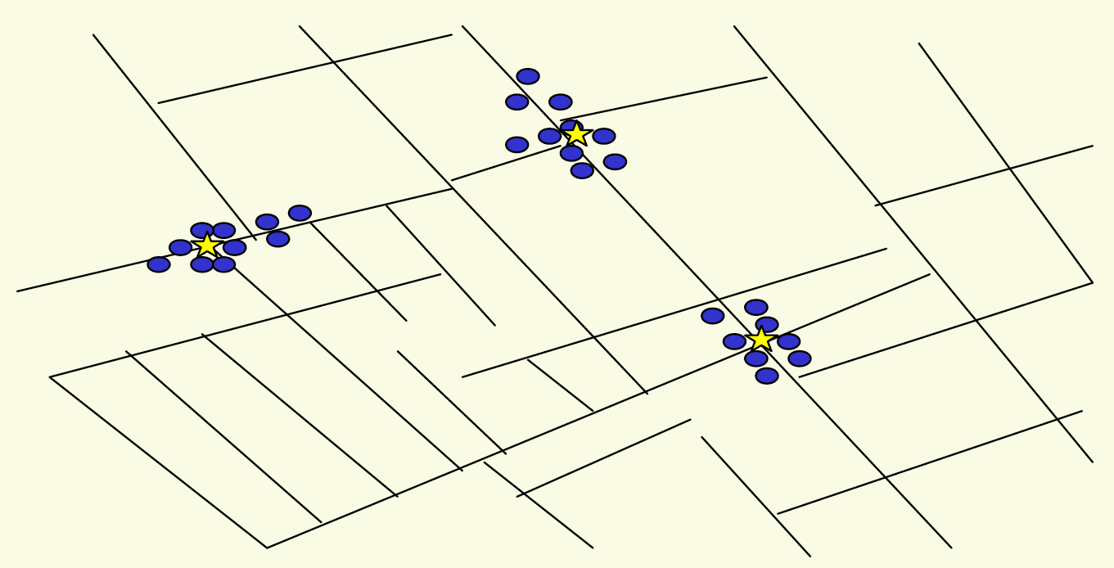
Clustering
Goal. Given a set U of n objects labeled p₁, …, p_{n}, partition into clusters so that objects in different clusters are far apart.
outbreak of cholera deaths in London in 1850s (Nina Mishra)
Applications.
・Routing in mobile ad hoc networks.
・Document categorization for web search.
・Similarity searching in medical image databases
・Skycat: cluster 10⁹ sky objects into stars, quasars, galaxies.
・...
43

Slide 47
Clustering of maximum spacing
k-clustering. Divide objects into k non-empty groups.
Distance function. Numeric value specifying "closeness" of two objects.
・d(p_{i}, p_{j}) = 0 iff p_{i} = p_{j}
[identity of indiscernibles] [nonnegativity] [symmetry]
・d(p_{i}, p_{j}) ≥ 0
・d(p_{i}, p_{j}) = d(p_{j}, p_{i})
Spacing. Min distance between any pair of points in different clusters.
Goal. Given an integer k, find a k-clustering of maximum spacing.
distance between two clusters
distance between two closest clusters
4-clustering
44

Slide 48
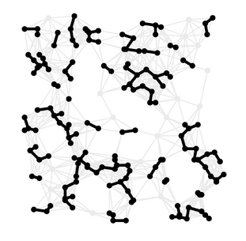
Greedy clustering algorithm
“Well-known” algorithm in science literature for single-linkage k-clustering:
・Form a graph on the node set U, corresponding to n clusters.
・Find the closest pair of objects such that each object is in a different cluster, and add an edge between them.
・Repeat n – k times until there are exactly k clusters.
Key observation. This procedure is precisely Kruskal's algorithm (except we stop when there are k connected components).
Alternative. Find an MST and delete the k – 1 longest edges.

Slide 49
Greedy clustering algorithm: analysis
Theorem. Let C* denote the clustering C*₁, …, C*_{k} formed by deleting the
k – 1 longest edges of an MST. Then, C* is a k-clustering of max spacing.
Pf. Let C denote some other clustering C₁, …, C_{k}.
・The spacing of C* is the length d* of the (k – 1)^{st} longest edge in MST.
・Let p_{i} and p_{j} be in the same cluster in C*, say C*_{r} , but different clusters
・Some edge (p, q) on p_{i} – p_{j} path in C*_{r} spans two different clusters in C.
in C, say C_{s} and C_{t}.
・Edge (p, q) has length ≤ d* since it wasn't deleted.
・Spacing of C is ≤ d* since p and q are in different clusters. ▪
C_{s} C_{t}
C*_{r}
edges left after deleting k – 1 longest edges from a MST
p_{i}
p
q
p
j

Slide 50
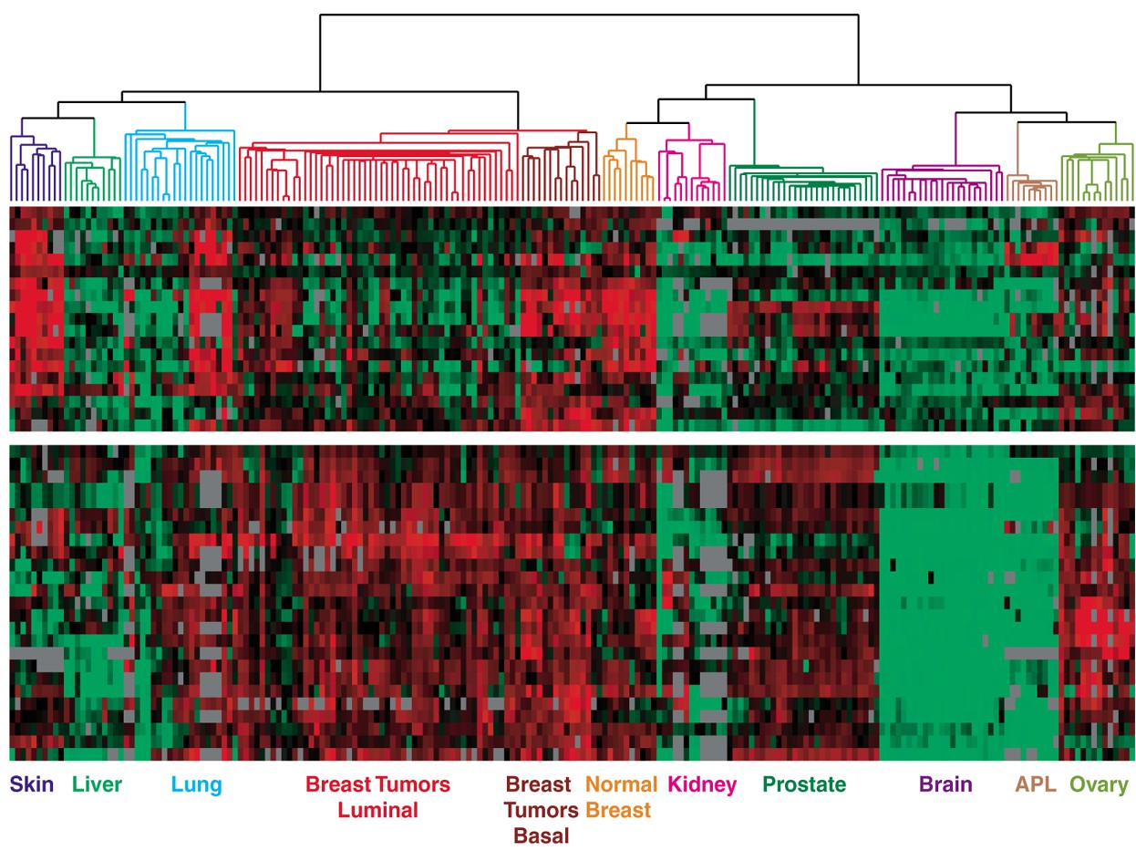
Dendrogram of cancers in human
Tumors in similar tissues cluster together.
gene 1
gene n
Reference: Botstein & Brown group
gene expressed
gene not expressed
47

Slide 51
4. Greedy Algorithms II
Dijkstra's algorithm
minimum spanning trees
Prim, Kruskal, Boruvka
single-link clustering
min-cost arborescences
Section 4.9

Slide 52

Arborescences
Def. Given a digraph G = (V, E) and a root r ∈ V, an arborescence (rooted at r) is a subgraph T = (V, F) such that
・T is a spanning tree of G if we ignore the direction of edges.
・There is a directed path in T from r to each other node v ∈ V.
r
Warmup. Given a digraph G, find an arborescence rooted at r (if one exists). Algorithm. BFS or DFS from r is an arborescence (iff all nodes reachable).

Slide 53
Arborescences
Def. Given a digraph G = (V, E) and a root r ∈ V, an arborescence (rooted at r) is a subgraph T = (V, F) such that
・T is a spanning tree of G if we ignore the direction of edges.
・There is a directed path in T from r to each other node v ∈ V.
Proposition. A subgraph T = (V, F) of G is an arborescence rooted at r iff
T has no directed cycles and each node v ≠ r has exactly one entering edge. Pf.
⇒ If T is an arborescence, then no (directed) cycles and every node v ≠ r
has exactly one entering edge—the last edge on the unique r↝v path.
⇐ Suppose T has no cycles and each node v ≠ r has one entering edge.
・To construct an r↝v path, start at v and repeatedly follow edges in the
・Since T has no directed cycles, the process must terminate.
backward direction.
・It must terminate at r since r is the only node with no entering edge. ▪

Slide 54

Min-cost arborescence problem
Problem. Given a digraph G with a root node r and with a nonnegative cost
ce ≥ 0 on each edge e, compute an arborescence rooted at r of minimum cost.
r
2
6
5
1
3
8
9
4
7
Assumption 1. G has an arborescence rooted at r.
Assumption 2. No edge enters r (safe to delete since they won't help).

Slide 55
Simple greedy approaches do not work
Observations. A min-cost arborescence need not:
・Be a shortest-paths tree.
・Include the cheapest edge (in some cut).
・Exclude the most expensive edge (in some cycle).
r
2
6
5
1
3
4

Slide 56
A sufficient optimality condition
Property. For each node v ≠ r, choose one cheapest edge entering v and let F* denote this set of n – 1 edges. If (V, F*) is an arborescence, then it is a min-cost arborescence.
Pf. An arborescence needs exactly one edge entering each node v ≠ r
and (V, F*) is the cheapest way to make these choices. ▪
r
1
6
5
2
3
8
9
4
7

Slide 57
A sufficient optimality condition
Property. For each node v ≠ r, choose one cheapest edge entering v and let F* denote this set of n – 1 edges. If (V, F*) is an arborescence, then it is a min-cost arborescence.
Note.
F* may not be an arborescence (since it may have directed cycles).
r
2
6
5
1
3
8
9
4
7

Slide 58



Reduced costs
Def. For each v ≠ r, let y(v) denote the min cost of any edge entering v. The reduced cost of an edge (u, v) is c'(u, v) = c(u, v) – y(v) ≥ 0.
Observation. T is a min-cost arborescence in G using costs c iff
T is a min-cost arborescence in G using reduced costs c'. Pf. Each arborescence has exactly one edge entering v.
costs c
reduced costs c'
r 1
1
9
r
2
9
0
7
1
3
3
0
0
4
0
4
3
y(v)

Slide 59
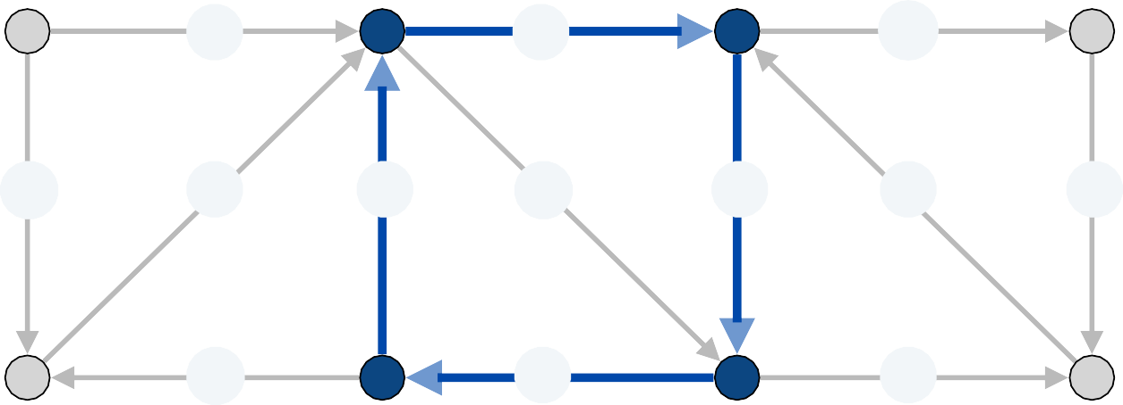
Edmonds branching algorithm: intuition
Intuition. Recall F* = set of cheapest edges entering v for each v ≠ r.
・Now, all edges in F* have 0 cost with respect to costs c'(u, v).
・If F* does not contain a cycle, then it is a min-cost arborescence.
・If F* contains a cycle C, can afford to use as many edges in C as desired.
・Contract nodes in C to a supernode.
・Recursively solve problem in contracted network G' with costs c'(u, v).
r
4
0
0
1
3
0
4
0
1
0
0
0
7

Slide 60
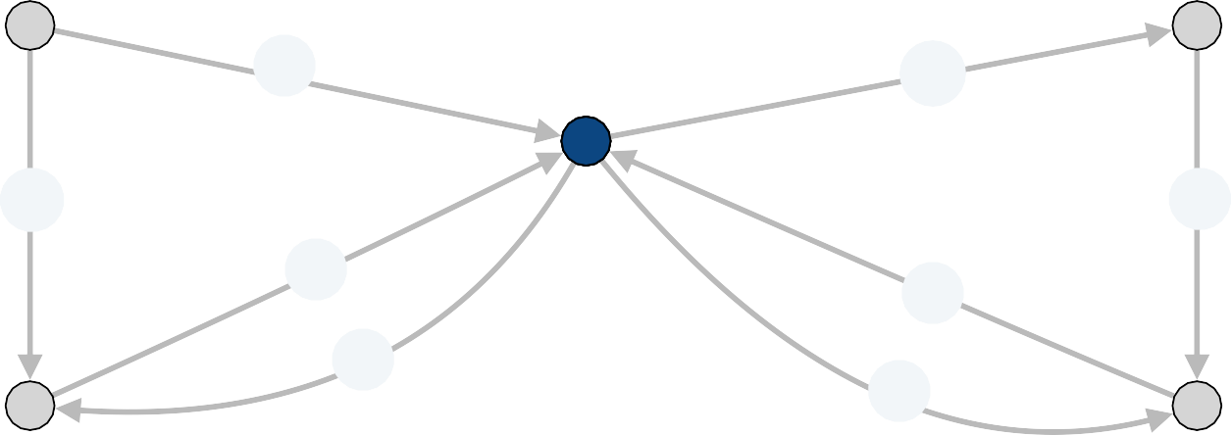
Edmonds branching algorithm: intuition
Intuition. Recall F* = set of cheapest edges entering v for each v ≠ r.
・Now, all edges in F* have 0 cost with respect to costs c'(u, v).
・If F* does not contain a cycle, then it is a min-cost arborescence.
・If F* contains a cycle C, can afford to use as many edges in C as desired.
・Contract nodes in C to a supernode (removing any self-loops).
・Recursively solve problem in contracted network G' with costs c'(u, v).
r
4
0
1
0
3
1
0
7

Slide 61
Edmonds branching algorithm
EdmondsBranching(G, r , c)
Foreach v ≠ r
y(v) ← min cost of an edge entering v.
c'(u, v) ← c'(u, v) – y(v) for each edge (u, v) entering v.
FOREACH v ≠ r: choose one 0-cost edge entering v and let F* be the resulting set of edges.
IF F* forms an arborescence, RETURN T = (V, F*).
Else
C ← directed cycle in F*.
Contract C to a single supernode, yielding G' = (V', E'). T' ← EDMONDSBRANCHING(G', r , c')
Extend T' to an arborescence T in G by adding all but one edge of C. RETURN T.

Slide 62
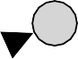
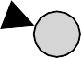


Edmonds branching algorithm
Q. What could go wrong?
A.
・Min-cost arborescence in G' has exactly one edge entering a node in C
(since C is contracted to a single node)
・But min-cost arborescence in G might have more edges entering C.
min-cost arborescence in G
cycle C
a
b
r

Slide 63
Edmonds branching algorithm: key lemma
Lemma. Let C be a cycle in G consisting of 0-cost edges. There exists a min- cost arborescence rooted at r that has exactly one edge entering C.
Pf. Let T be a min-cost arborescence rooted at r. Case 0. T has no edges entering C.
Since T is an arborescence, there is an r↝v path fore each node v ⇒
at least one edge enters C.
Case 1. T has exactly one edge entering C. T satisfies the lemma.
Case 2. T has more than one edge that enters C.
We construct another min-cost arborescence T' that has exactly one edge entering C.

Slide 64

Edmonds branching algorithm: key lemma
Case 2 construction of T'.
・Let (a, b) be an edge in T entering C that lies on a shortest path from r.
・We delete all edges of T that enter a node in C except (a, b).
・We add in all edges of C except the one that enters b.
path from r to C uses only one node in C
T
cycle C
a
b
r

Slide 65


Edmonds branching algorithm: key lemma
Case 2 construction of T'.
・Let (a, b) be an edge in T entering C that lies on a shortest path from r.
・We delete all edges of T that enter a node in C except (a, b).
・We add in all edges of C except the one that enters b.
path from r to C uses only one node in C
Claim. T' is a min-cost arborescence.
・The cost of T' is at most that of T since we add only 0-cost edges.
・T' has exactly one edge entering each node v ≠ r.
・T' has no directed cycles.
T is an arborescence rooted at r
(T had no cycles before; no cycles within C; now only (a, b) enters C)
T'
cycle C
and the only path in T' to a is the path from r to a (since any path must follow unique entering edge back to r)
a
b
r

Slide 66
Edmonds branching algorithm: analysis
Theorem. [Chu-Liu 1965, Edmonds 1967] The greedy algorithm finds a min-cost arborescence.
Pf. [by induction on number of nodes in G]
・If the edges of F* form an arborescence, then min-cost arborescence.
・Otherwise, we use reduced costs, which is equivalent.
・After contracting a 0-cost cycle C to obtain a smaller graph G',
the algorithm finds a min-cost arborescence T' in G' (by induction).
・Key lemma: there exists a min-cost arborescence T in G that corresponds to T'. ▪
Theorem. The greedy algorithm can be implemented in O(m n) time. Pf.
・At most n contractions (since each reduces the number of nodes).
・Finding and contracting the cycle C takes O(m) time.
・Transforming T' into T takes O(m) time. ▪

Slide 67
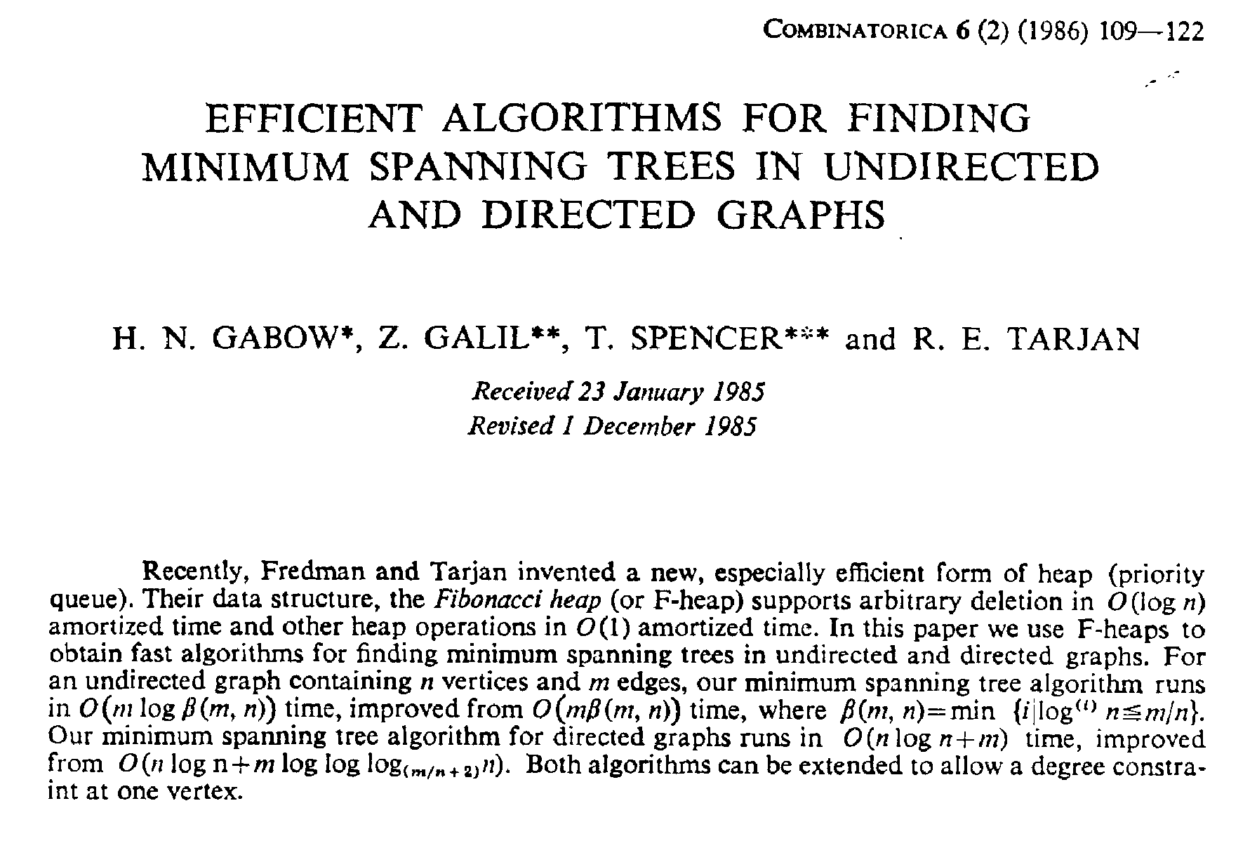
Min-cost arborescence
Theorem. [Gabow-Galil-Spencer-Tarjan 1985] There exists an O(m + n log n)
time algorithm to compute a min-cost arborescence.

